Slide 1

Digital Portfolio
STUDENT NAME: Sakthipriyan R
REGISTER NO AND NMID: 222400470 / asunm103222400470
Naan Mudhalvan ID: E60118500299337BA804B69E8EE50DD0
DEPARTMENT: B.Sc Computer Science
COLLEGE: S.I.V.E.T COLLEGE

Slide 2
PROJECT TITLE
Designed to Impress – Portfolio Website

Slide 3
AGENDA
Problem Statement
Project Overview
End Users
Tools and Technologies
Portfolio design and Layout
Features and Functionality
Results and Screenshots
Conclusion
Github Link
3/21/2024 Annual Review

Slide 4
PROBLEM STATEMENT
• Many students and budding developers struggle to create an organized way to showcase their skills, projects, and certificates to potential employers or collaborators.
• This portfolio solves that by providing a structured, responsive, and visually appealing presentation of work.

Slide 5
PROJECT OVERVIEW
• A responsive personal portfolio website built using HTML, CSS, and JavaScript.
• Professional look
• Easy navigation
• Showcases skills, projects, and achievements
• Contact form for interaction

Slide 6

WHO ARE THE END USERS?
• Students
• Aspiring developers
• Hiring managers
• Online course participants
• This portfolio helps users build their
• online presence and share their skills effectively.

Slide 7
TOOLS AND TECHNIQUES
• HTML-Structure web pages
• search CSS-Style and layout
• JavaScript - Add interactivity
• GitHub - Code hosting
• Responsive Design - Works on desktop and mobile devices

Slide 8
POTFOLIO DESIGN AND LAYOUT
• Clean navigation: About, Skills, Projects, Certificates, Contact
• Organized content for readability
• Mobile-friendly and visually appealing
• Uses icons and cards to highlight information
8

Slide 9
FEATURES AND FUNCTIONALITY
• Responsive web layout
• Interactive forms
• Project showcases with descriptions
• Certificates section for achievements
• Contact form with email and phone details

Slide 10
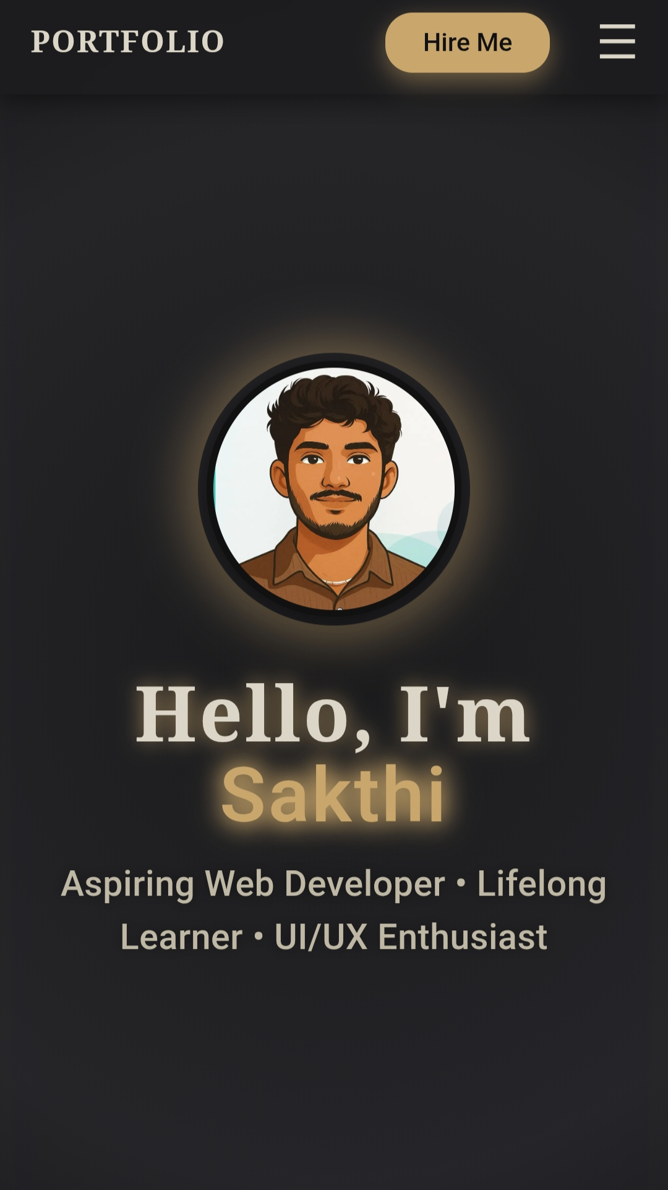
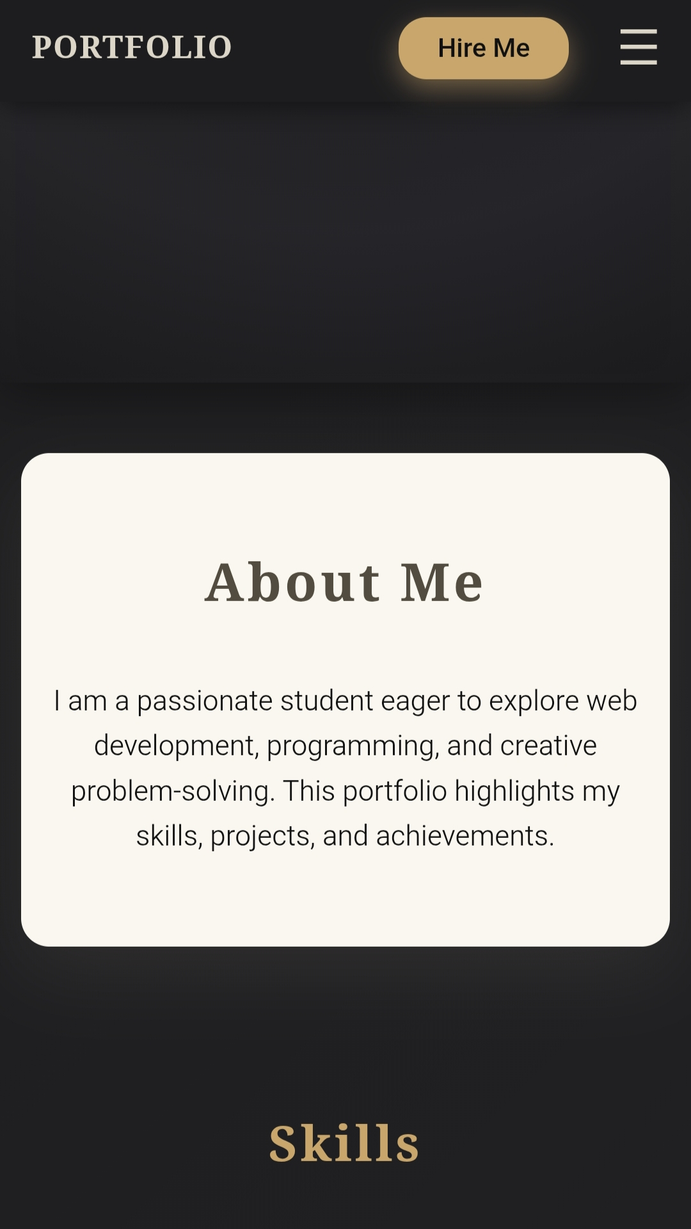
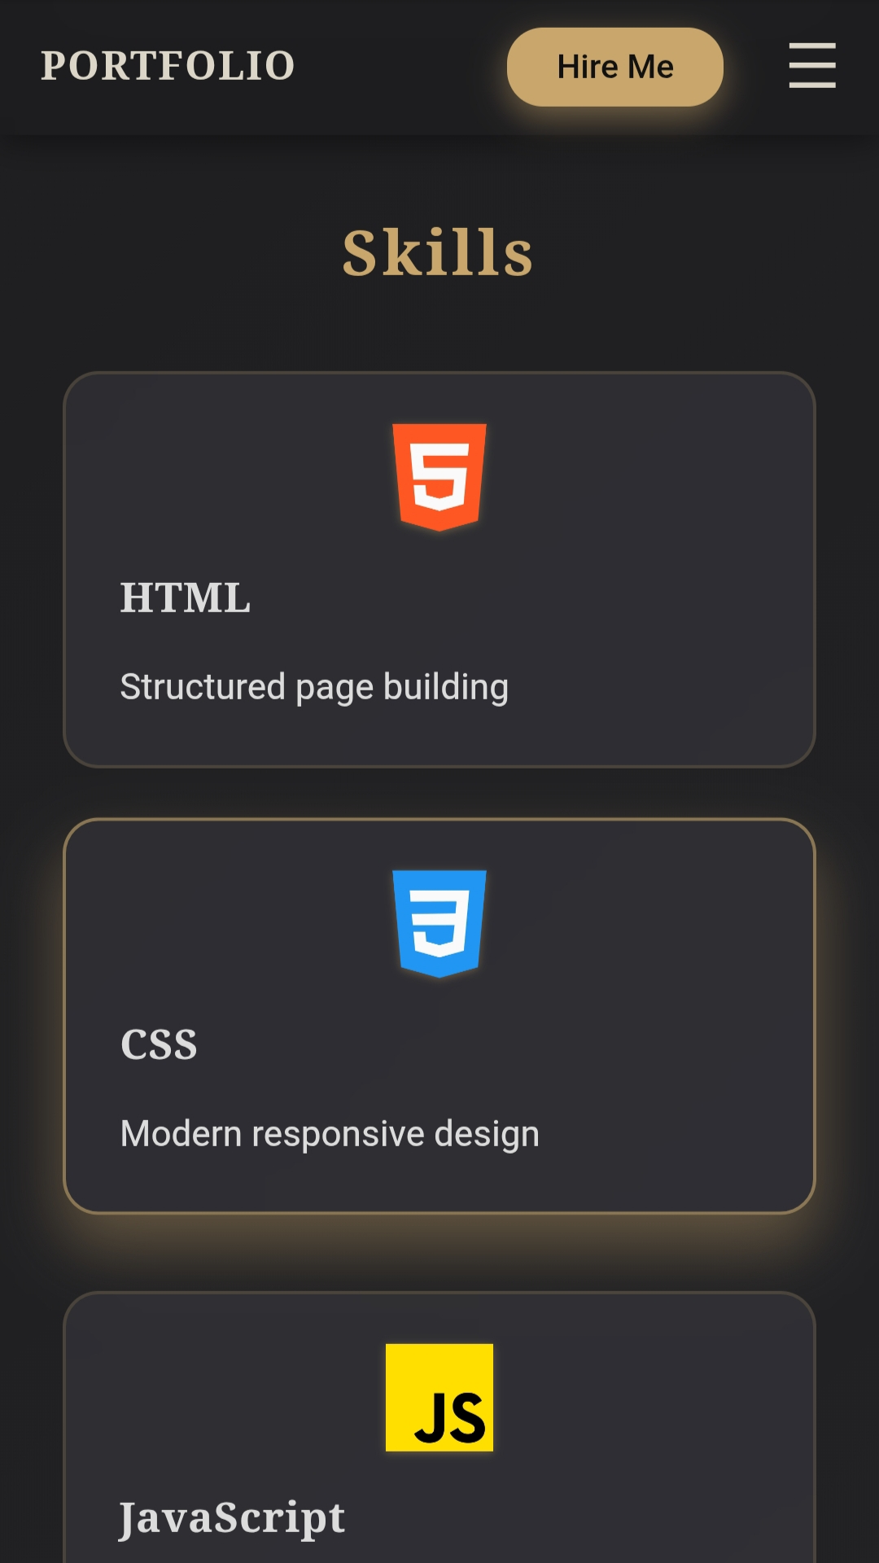
RESULTS AND SCREENSHOTS
3/21/2024 Annual Review
10

Slide 11
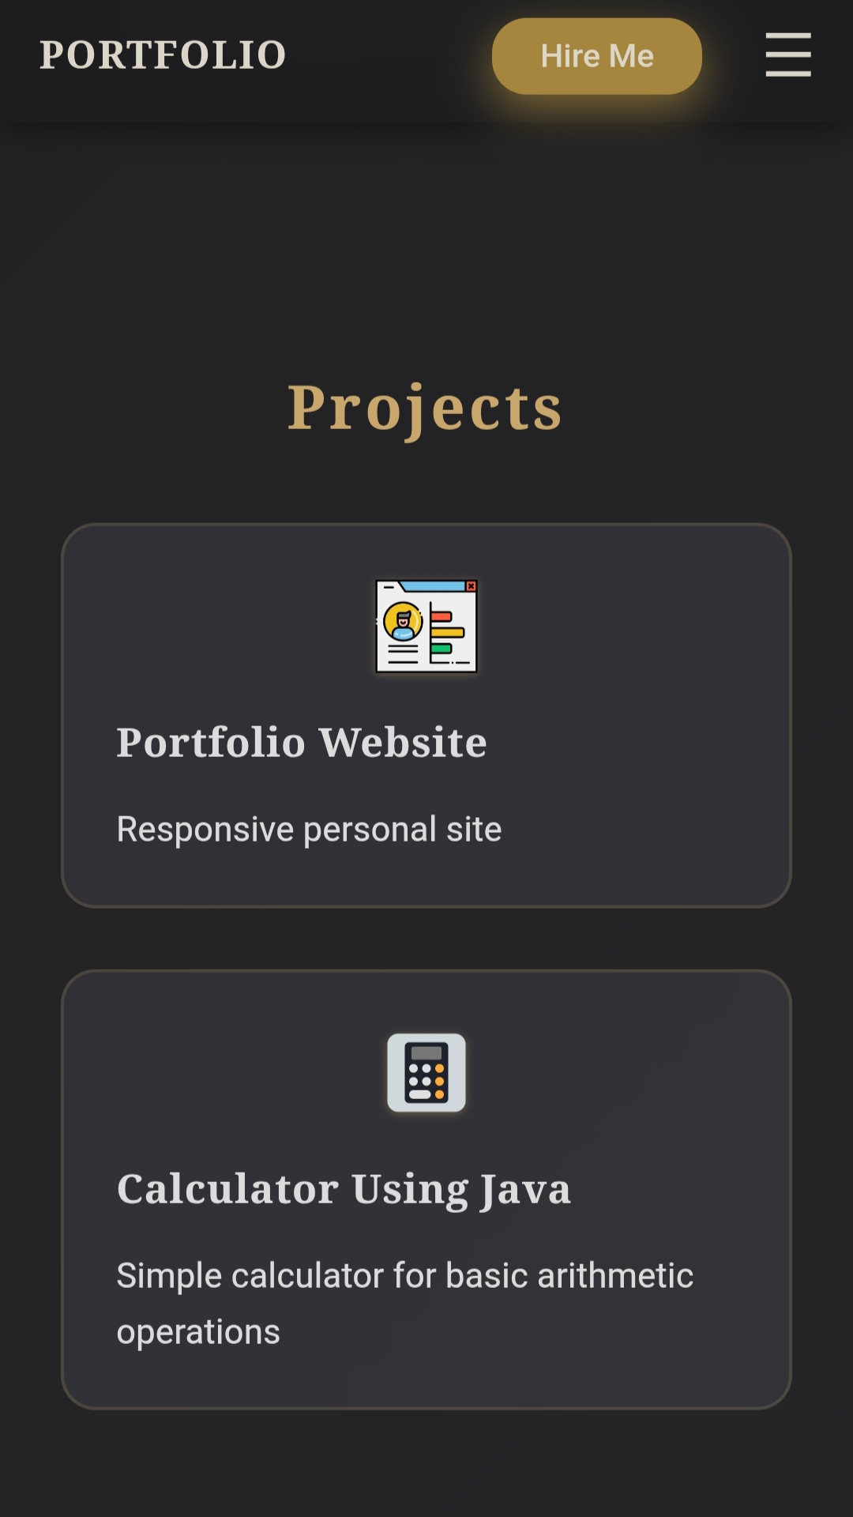
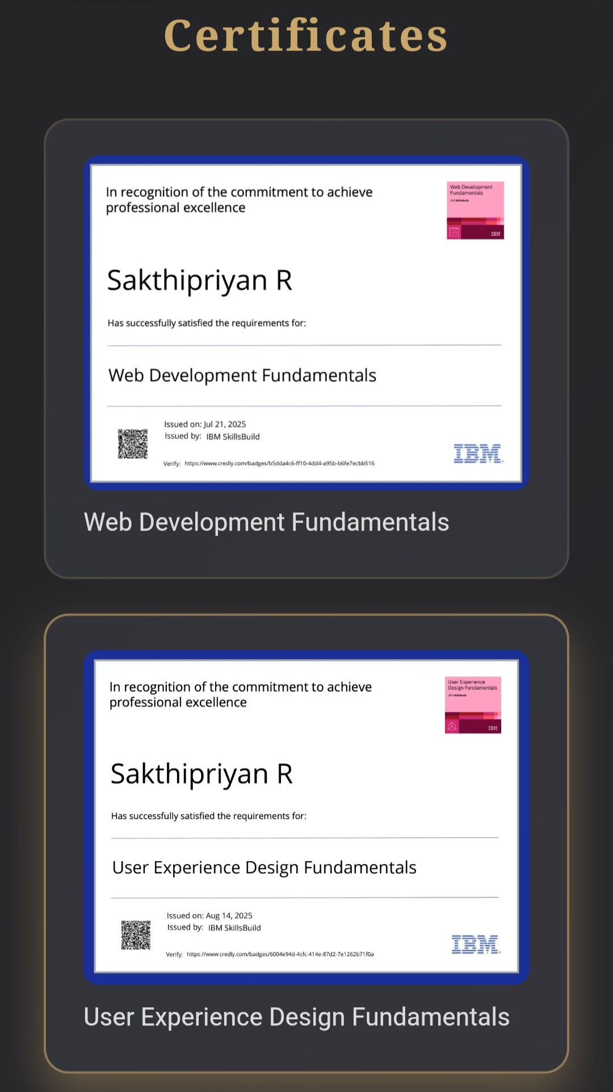
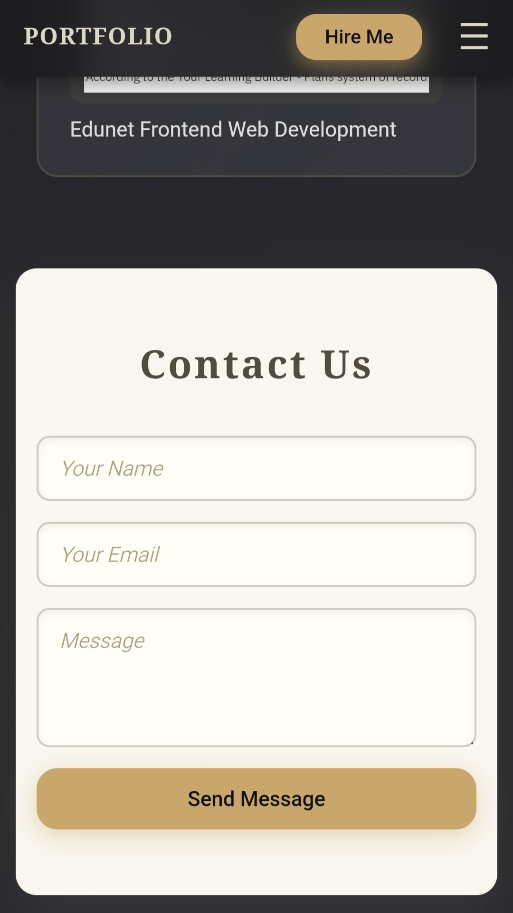
RESULTS AND SCREENSHOTS

Slide 12
CONCLUSION
• This portfolio is an effective way to present personal skills, projects, and accomplishments
• It serves as a stepping stone for career development and personal branding in the digital space.
12

Slide 13
GitHub Link
Check out the project on GitHub:
🔗 https://github.com/Sakthipriyan-coder/Portfolio.git
Feel free to explore, give feedback, and collaborate!

